Slide 1
TRATAMIENTO SISTEMICO CANCER DE COLON
24 de febrero 2023
Programa de acreditación oncológica para médicos residentes
Md. Karen Barragán
Tutora: Dra. Verónica Pérez

Slide 2
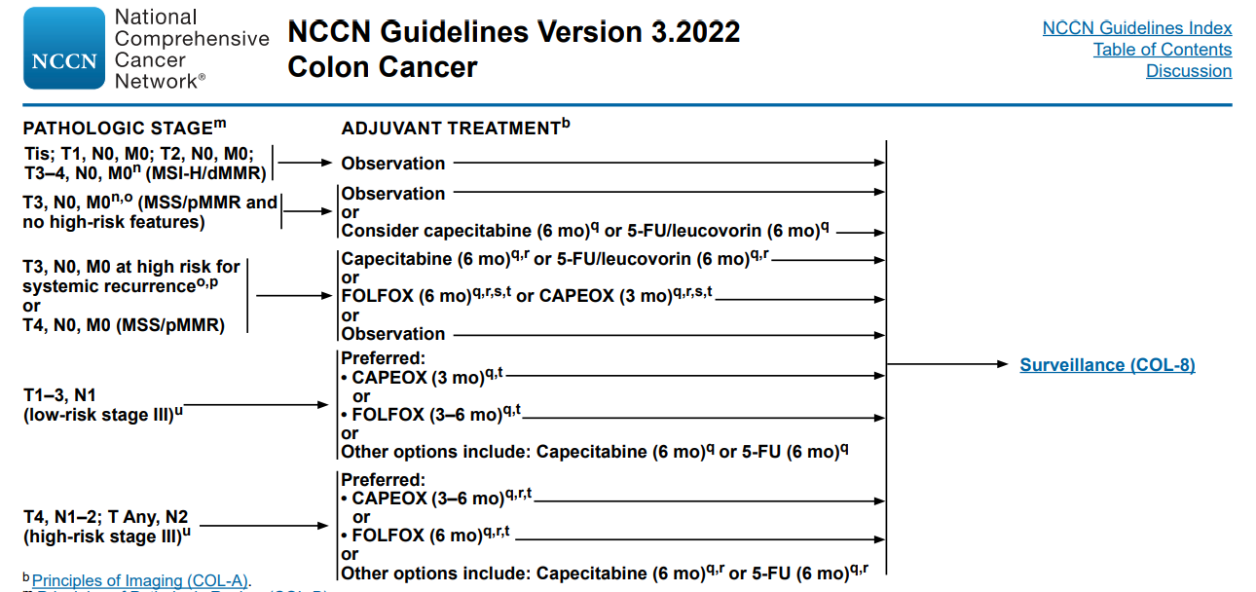
Surgery
Surgery ± QT
Surgery → QT
QT
Version3.2022, 1/25/23©2023 National Comprehensive Cancer Network®(NCCN®), All rights reserved. NCCN Guidelines® and this illustration may not be reproduced in any form without the express written permission.

Slide 3
Adjuvant
Stage II : pT3-4N0
DNA mismatch repair (MMR) enzyme status/high levels of microsatellite instability (dMMR/MSI-H)
Treatment decisions must be individualized
High risk clinicopathologic features:
<12 sampled lymph nodes
Perineural or lymphovascular invasion
Clinical intestinal obstruction, perforation
Grade BD3 tumor budding (10 buds or more)
Poorly differentiated or undifferentiated tumor grade
MMR status - prognostic factor
National Comprehensive Cancer Network (NCCN). NCCN clinical practice guidelines in oncology. Available at: https://www.nccn.org/professionals/physician_gls (Accessed on May 18, 2022).

Slide 4
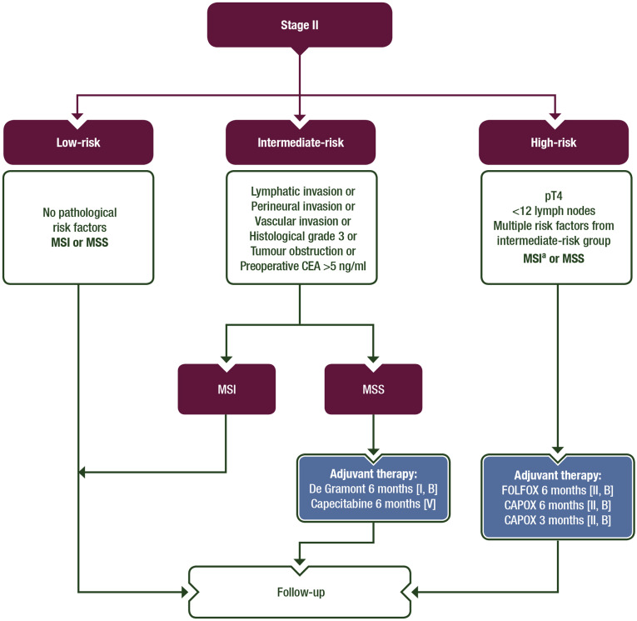
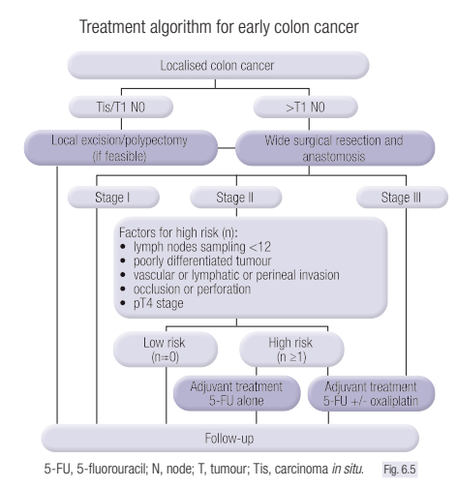
Adjuvant treatment of stage II colon cancer
Argilés, G., Tabernero, J., Labianca, R., Hochhauser, D., Salazar, R., Iveson, T., Laurent-Puig, P., Quirke, P., Yoshino, T., Taieb, J ., Martinelli, E., Arnold, D. y Comité de Directrices de la ESMO. Dirección electrónica: Clinicalguidelines@esmo.org. (2020). Cáncer de colon localizado: Guía de práctica clínica de la ESMO para el diagnóstico, tratamiento y seguimiento. Anales de oncología , 31 (10), 1291–1305. https://doi.org/10.1016/j.annonc.2020.06.022

Slide 5
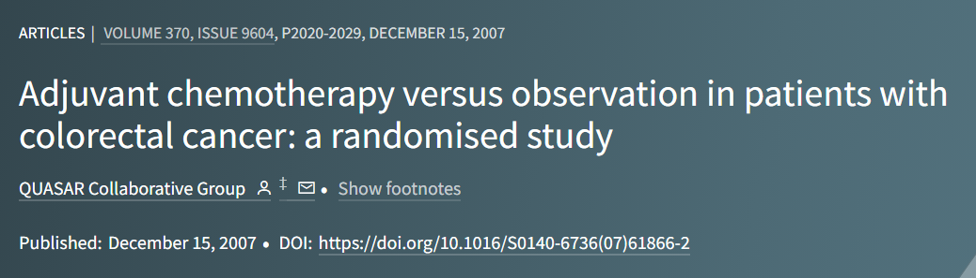
Adjuvant treatment of stage II colon cancer
associated with a significant 22 percent lower risk of disease recurrence,
18 percent reduction in death, 3 to 4 percent absolute benefit in five-year
FU/LV – CAPECITABINA SIN OXALIPLATINO

Slide 6
Adjuvant treatment of stage II colon cancer
Treatment according to risk subgroups: CAPECITABINA D1-D14, cada 3 semanas por 8 ciclos. / 5FU, cada 14 dias por 12 ciclos.
Low-risk: follow-up is recommended
Intermediate risk: fluoropyrimidines should be recommended
It is important to start adjuvant chemotherapy as soon as possible after surgery and ideally not later than 8 weeks.
ESMO. (s/f). Localised colon cancer. Esmo.org, de https://www.esmo.org/guidelines/guidelines-by-topic/gastrointestinal-cancers/localised-colon-cancer

Slide 7
Adjuvant
Stage III :
Eradicate micrometastases
Reducing disease recurrence
Increasing the cure rate
(node-positive), reduction an approximately 30% risk of disease recurrence and a 22 to 32 % reduction in mortality.
NCCTG: FU/LV - 12 meses, ↑SVE - SG
National Comprehensive Cancer Network (NCCN). NCCN clinical practice guidelines in oncology. Available at: https://www.nccn.org/professionals/physician_gls (Accessed on May 18, 2022).

Slide 8
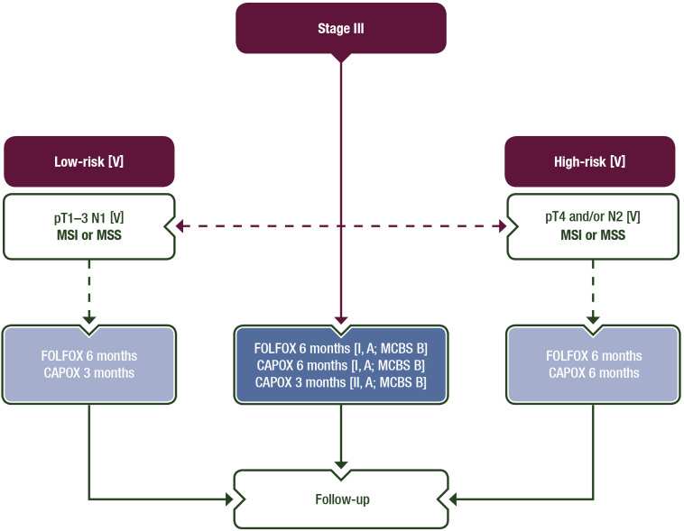
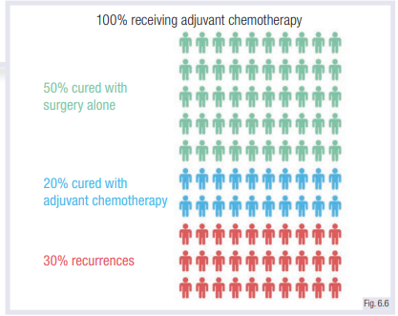
Adjuvant treatment of stage III colon cancer
Argilés, G., Tabernero, J., Labianca, R., Hochhauser, D., Salazar, R., Iveson, T., Laurent-Puig, P., Quirke, P., Yoshino, T., Taieb, J ., Martinelli, E., Arnold, D. y Comité de Directrices de la ESMO. Dirección electrónica: Clinicalguidelines@esmo.org. (2020). Cáncer de colon localizado: Guía de práctica clínica de la ESMO para el diagnóstico, tratamiento y seguimiento. Anales de oncología , 31 (10), 1291–1305. https://doi.org/10.1016/j.annonc.2020.06.022

Slide 9
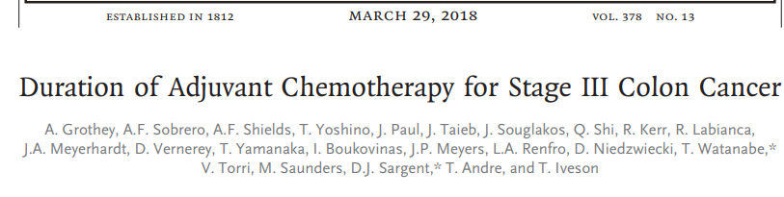
Adjuvant treatment of stage III colon cancer
Combinations of: 5-FU or capecitabine, and oxaliplatin (ESMO-MCBS)
Oxaliplatin-based adjuvant treatment - 3 or 6 months for CAPOX or 6 months for FOLFOX + consideration pathological risk characteristics, patient comorbidity and risk assessment.
Is important to start adjuvant chemotherapy as soon as possible after surgery and ideally not later than 8 weeks.
André T, Iveson T, Labianca R, Meyerhardt JA, Souglakos I, Yoshino T, et al. The IDEA (International Duration Evaluation of Adjuvant Chemotherapy) Collaboration: Prospective Combined Analysis of Phase III Trials Investigating Duration of Adjuvant Therapy with the FOLFOX (FOLFOX4 or Modified FOLFOX6) or XELOX (3 versus 6 months) Regimen for Patients with Stage III Colon Cancer: Trial Design and Current Status. Curr Colorectal Cancer Rep. 2013;9(3):261-9.

Slide 10
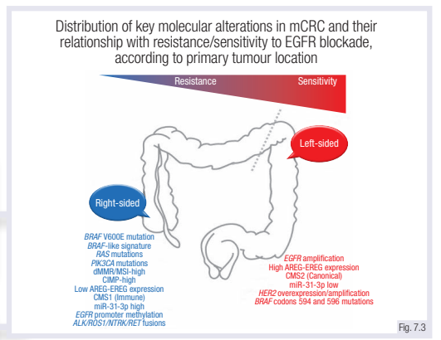
METASTATIC DISEASE
15%-30% present with metastases,
20%-50%, patients with initially localised
disease will develop metastases.
Most common location:
liver, lung, peritoneum and
distant lymph nodes.
Resectable/unresectable
*Terapia de conversión
National Comprehensive Cancer Network (NCCN). NCCN clinical practice guidelines in oncology. Available at: https://www.nccn.org/professionals/physician_gls (Accessed on May 18, 2022).

Slide 11
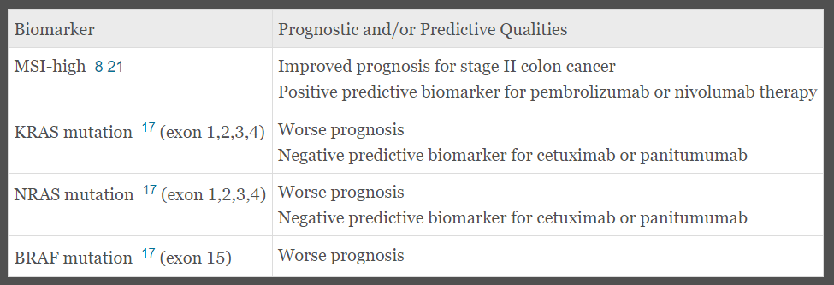
Biomarkers
Irresecable – conversión -
KRAS MUTADO: FOLFOX + CETUXIMAB O PANITUMUMAB
KRAS NO MUTADO: FOLFIRI + BEVACIZUMAB – CIRUGIA - QT
Wu, C. (2018). Systemic Therapy for Colon Cancer. Surgical oncology clinics of North America, 27(2), 235–242. https://doi.org/10.1016/j.soc.2017.11.001

Slide 12
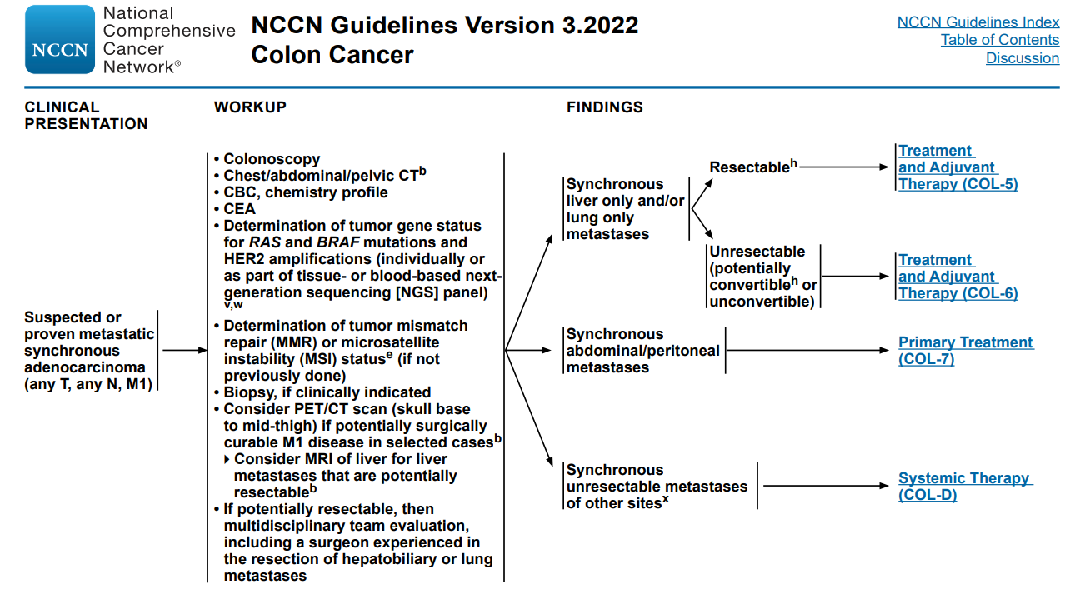
A pesar del tratamiento adyuvante, ~25%-30% de radicalmente los pacientes con cáncer de colon resecado desarrollarán metástasis.

Slide 13
Neoadjuvant, terapia de conversión
Reduce the subsequent impact of micrometastases
Downsizing the primary tumor to improve the likelihood of negative surgical margins
Improved compliance with systemic therapy
Locally unresectable colon cancer, margins of resection are potentially compromised, or inoperable.
(NCCN) 2016, included neoadjuvant chemotherapy as a treatment option for patients with bulky nodal disease or clinical T4b.
National Comprehensive Cancer Network (NCCN). NCCN clinical practice guidelines in oncology. Available at: https://www.nccn.org/professionals/physician_gls (Accessed on May 18, 2022).

Slide 14
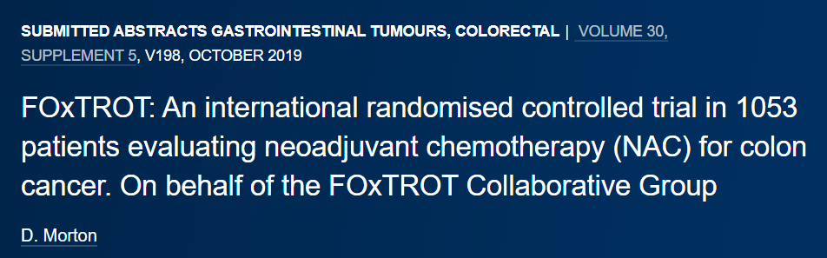
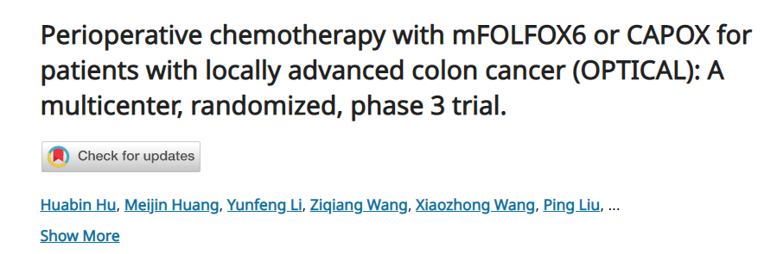
Chemotherapy

Slide 15
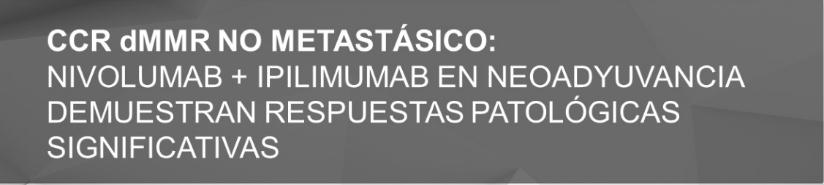
Immunotherapy
Septiembre 12, 2022
Respuestas patológicas favorables con la combinación de nivolumab + ipilimumab.
99% de los pacientes experimentaron respuesta patológica y el 67% obtuvo una respuesta patológica completa.

Slide 16
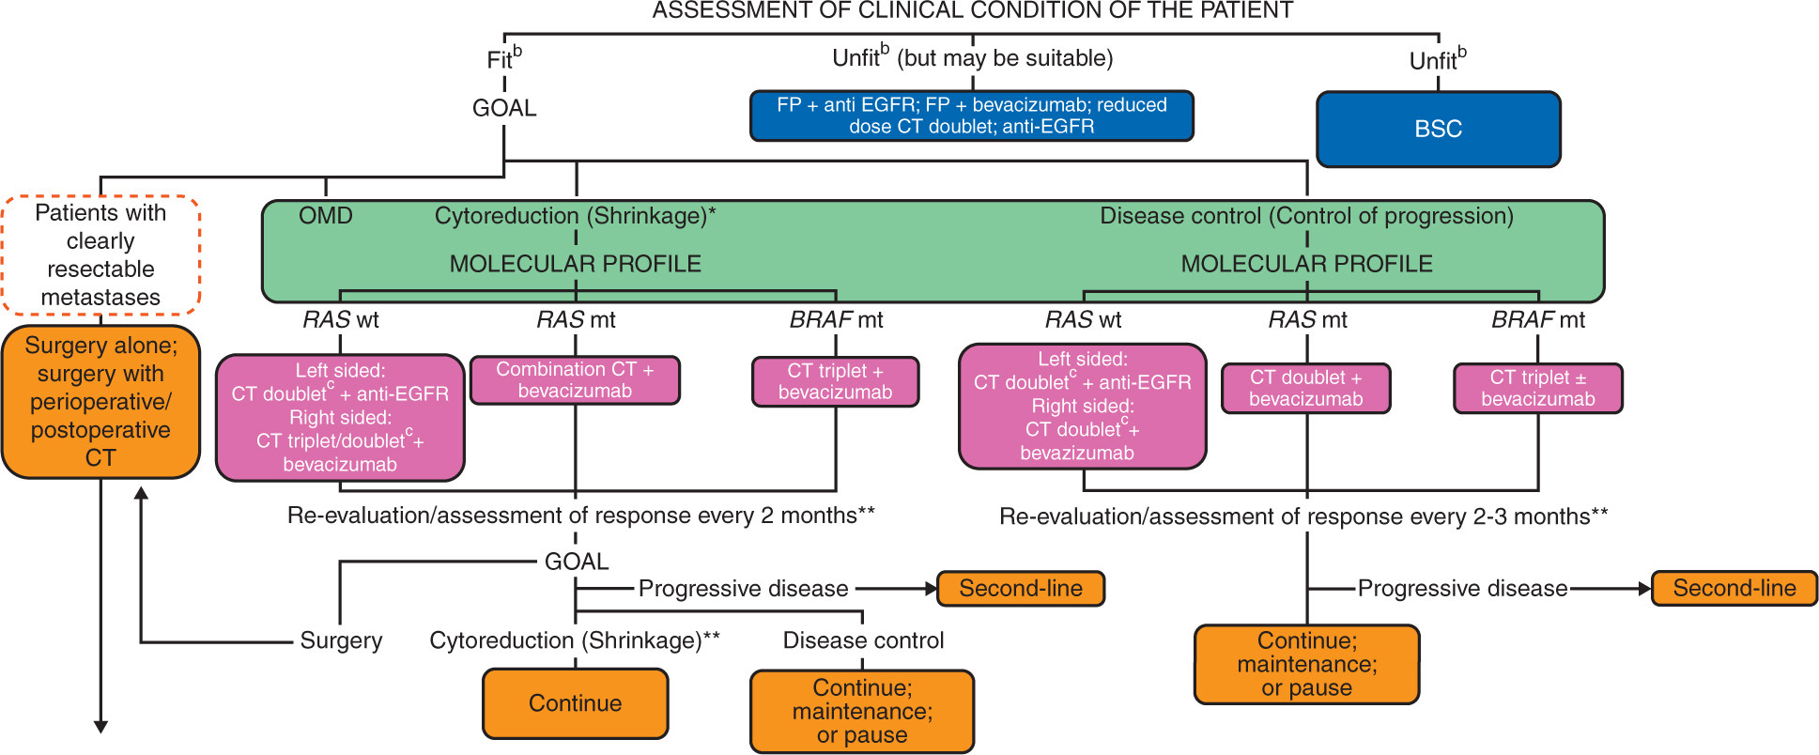
Annals of Oncology 2023 3410-32DOI: (10.1016/j.annonc.2022.10.003)
Copyright © 2022 European Society for Medical Oncology Terms and Conditions

Slide 17
Primera línea: QT + ANTI GFR: FOLFOX, FOLFIRI, CAPOX, FOFOXIRI
Segunda línea: QT + ANTI GFR: OXALIPLATINO → IRINOTECAN
- Condición clínica, en base a régimen previo.
- FOLFOXIRI: MANTENIMIENTO
+ ANTI GFR → ANTIANGIOGENICO
Tercera línea: CETUXIMAB, (+ IRINOTECAN), PANITUMUMAB (RAS Y BRAF NO MUTADO)
- 30-40%
- Prolongar la supervivencia
Preservar una adecuada calidad de vida
REFRACTARIO: REGORAFENIB - TRIFLURIDINE/TIPIRACIL

Slide 18
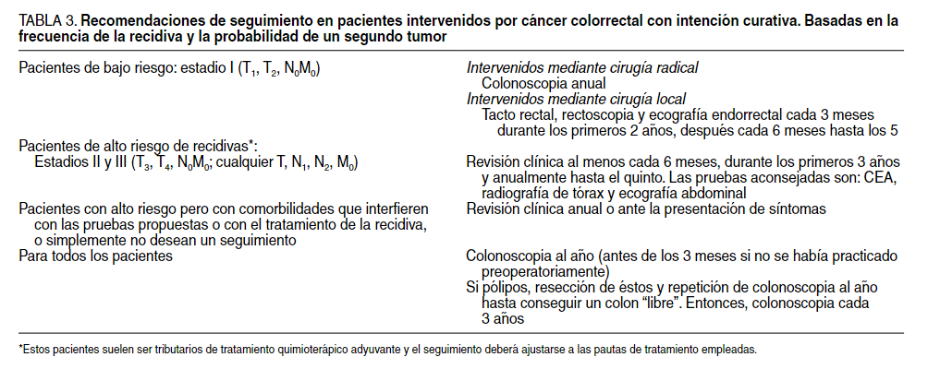
Ramírez-Rodríguez, JM, & Aguilella-Diago, V. (2005). Recidiva local en el cáncer de colon y recto. Cirugía española , 78 (6), 344–350. https://doi.org/10.1016/s0009-739x(05)70952-0

Slide 19
La caracterización de las alteraciones moleculares específicas es cada vez más crucial no solo para excluir a los pacientes de recibir tratamientos ineficaces, sino para asegurar tratamientos específicos.
El tratamiento sea individualizado en función de sus perfiles moleculares, estadio de la enfermedad, síntomas y comorbilidades
Multidisciplinary
Surgical resection is the only curative modality for localized colon cancer.

Slide 20
BIBLIOGRAFIA
Red Nacional Integral del Cáncer (NCCN). Pautas de práctica clínica de NCCN en oncología. Disponible en: https://www.nccn.org/professionals/physician_gls (Consultado el 18 de mayo de 2022).
Detección temprana del cáncer colorrectal: resumen de la guía estratificada de recursos de la ASCO. Disponible en línea en: https://ascopubs.org/doi/10.1200/OP.22.00 580.
ESMO. (s/f). Cáncer de colon localizado . Esmo.org. https://www.esmo.org/guidelines/guidelines-by-topic/gastrointestinal-cancers/localised-colon-cancer.

